Slide 1

HEVA Fund Tracker
HEVA TRACKER
Supporting Creatives
Presented By Anngladys Gichuhi

Slide 2

ABOUT US
HEVA Fund
HEVA Tracker is a comprehensive web-based platform designed to support creative entrepreneurs across East Africa through funding, capacity building, and research. The application serves as a centralized hub for tracking startup progress, managing fund disbursements, collecting data, and generating strategic insights for program administrators and stakeholders.

Slide 3
PROBLEM
Problem 1
Problem 2
Problem 3
Unaggregated data
No data visualisations
Lack of searchability

Slide 4
SOLUTIONS
Data Aggregation & VIsualization
Searchability
Aggregated data from all data sources
Easy to upload data in bulk, view graphs, charts
Search by country, value chain, funding model, organization, individual
Accessibility Options
Future-Facing
PWA, Work offline, sync later, English, French, Arabic, Light, dark, high-contrast, font resizing modes
Future facing - accepts all media files, trancribes audio, puts the information in the correct sectors, ERP Compatibility

Slide 5



OUR SERVICE
System Creation
Data Migration
System Maintenance
Innovative solutions custom-made for HEVA Fund
Aggregate and import data into the HEVA Tracker
Future-conscious continuous maintenance for sustainability and scalability

Slide 6
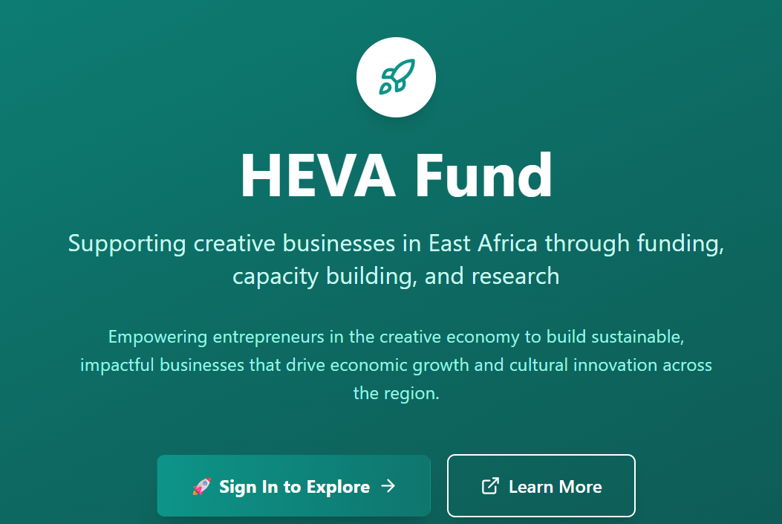
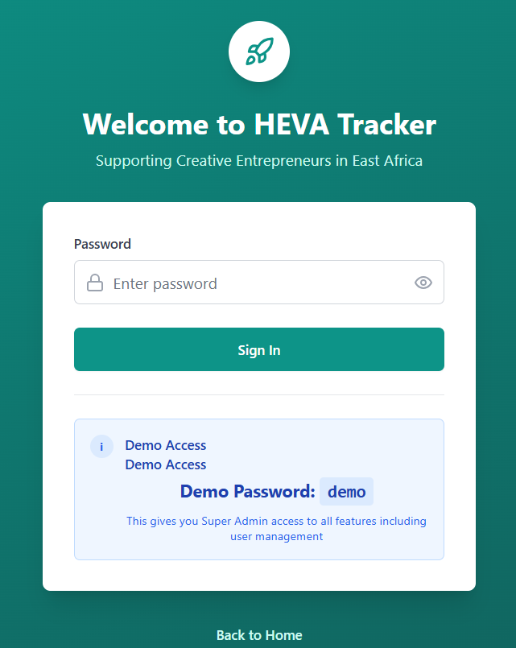

Slide 7
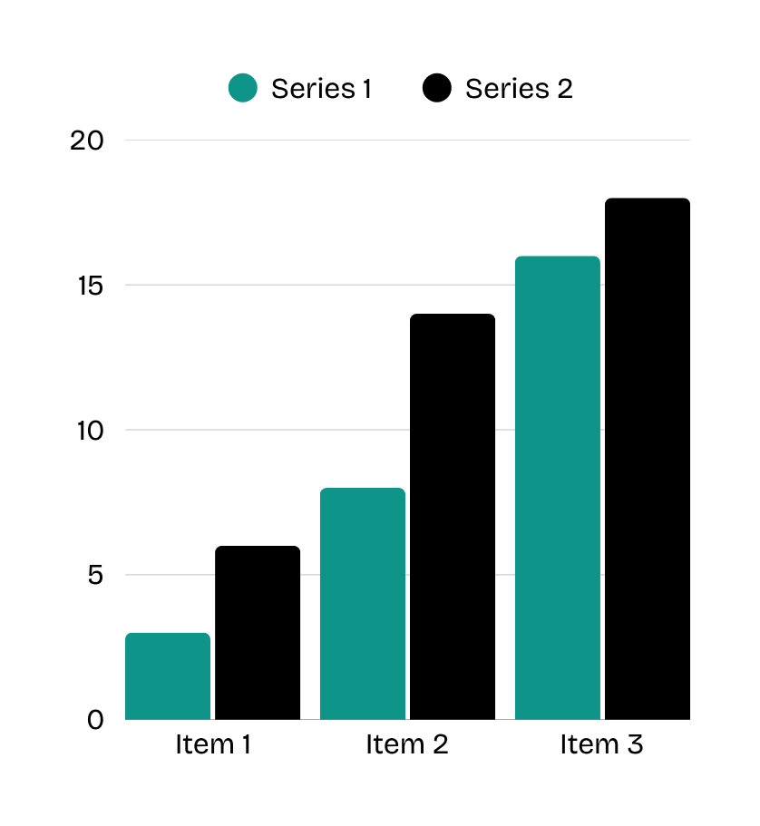

DATA ANALYSIS
Pie Charts
Vertical and horizontal bar graphs
Line charts

Slide 8
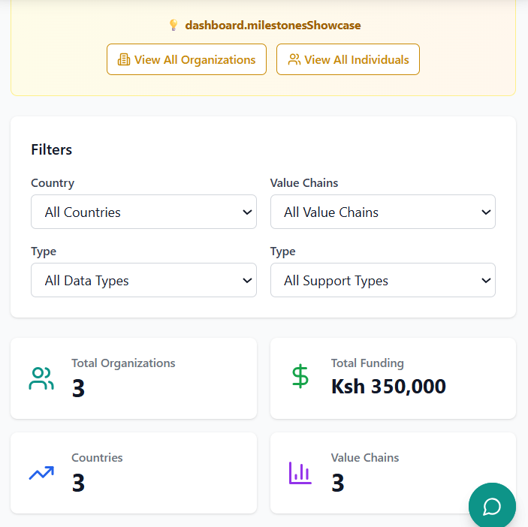
View organizations
View individuals
Search by country, value chain, data type, support types
Snapshot analytics
Chatbot

Slide 9



OUR TEAM
Anngladys Gichuhi
PLP Mentors
HEVA Fund Guides
SOFTWARE ENGINEER
SOFTWARE ENGINEERS
FUNDING ORGANIZATION

Slide 10
HEVA Fund Tracker
THANK YOU
Thanks ForListening
Presented By Anngladys Gichuhi

